Slide 1
PageRank Optimization for Graph Clustering
Group2:
Alp Ege Baştürk
Ecem İlgün Gürkan Bor
Gündüz Hüseynli

Slide 2
Literature Review
Random Walk With Restarts
Personalized PageRank
Clustering and Link Prediction
Notes:
We have searched papers to decide what can be done. There were many algorithms based on Pagerank such as <Read List>. We have tried to choose applicable algorithms considering both local and global clustering. We have decided to use 2 papers. One of them improved the quality of clusters while the other one was improving the calculation. We couldn’t implement the performance upgrade but we have implemented the one to improve quality. Later applied test using different parameters and graphs..

Slide 3
Survey on the Topic
RANDOM WALKS IN SOCIAL NETWORKS AND THEIR APPLICATIONS: A SURVEY
Purnamrita Sarkar, Andrew W. Moore

Slide 4
Academic Work Related to RWWR
Improving Random Walk Estimation Accuracy with Uniform Restarts
Supervised Random Walks: Predicting and Recommending Links in Social Networks
Local Graph Clustering by Multi-network Random Walk with Restart
Random Walks with Restarts for Graph-Based Classification: Teleportation Tuning and Sampling Design

Slide 5
RWWR Continued
Fast Random Walk with Restart and Its Applications
Fast and Accurate Random Walk with Restart on Dynamic Graphs with Guarantees
An Improved Random Walk Based Clustering Algorithm for Community Detection in Complex Networks

Slide 6
PPR and Related Work
Mean Field Analysis of Personalized PageRank with Implications for Local Graph Clustering
Personalized PageRank Clustering: A graph clustering algorithm based on random walks
Second-order random walk-based proximity measures in graph analysis: formulations and algorithms

Slide 7
Clustering and Link Prediction
From biological to social networks: Link prediction based on multi-way spectral clustering
The Link Prediction Problem for Social Networks
Link prediction based on local random walk
Local Graph Clustering and Applications to Graph Partitioning
Local Clustering Algorithm for Massive Graphs and its Application to Nearly-Linear Time Graph Partitioning
Parallel Local Graph Clustering
Memetic Graph Clustering

Slide 8

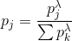
PageRank Formulation
Adding tuning factor to re-normalize the probabilities of P
Notes:
From paper of BINGJING CAI et.al.
O(N^3) process O(m^2) post-process

Slide 9
Clustering Tests
Test1
lambda | 1.2
sim_threshold | 0.01
cluster_merge_threshold | 0.4
NumClusters_PRM | 11
NumClusters_PR | 11
Conductance_PRM | 20.72456
Conductance_Normal | 21.16332
Test1.2
lambda | 2
sim_threshold | 0.01
cluster_merge_threshold | 0.4
NumClusters_PRM | 12
NumClusters_PR | 11
Conductance_PRM | 26.8223
Conductance_Normal | 21.16332
Algorithms were applied on FootballTSE graph [1], [2].
Notes:
-Changed lambda, resulted in increase in cluster number.
-intercluster conductance δ(C) is the maximum conductance value over all induced cuts (Ci, V \ Ci).
-Modified version was slightly faster in terms of time. -alpha = 0.85 (Google Default)

Slide 10
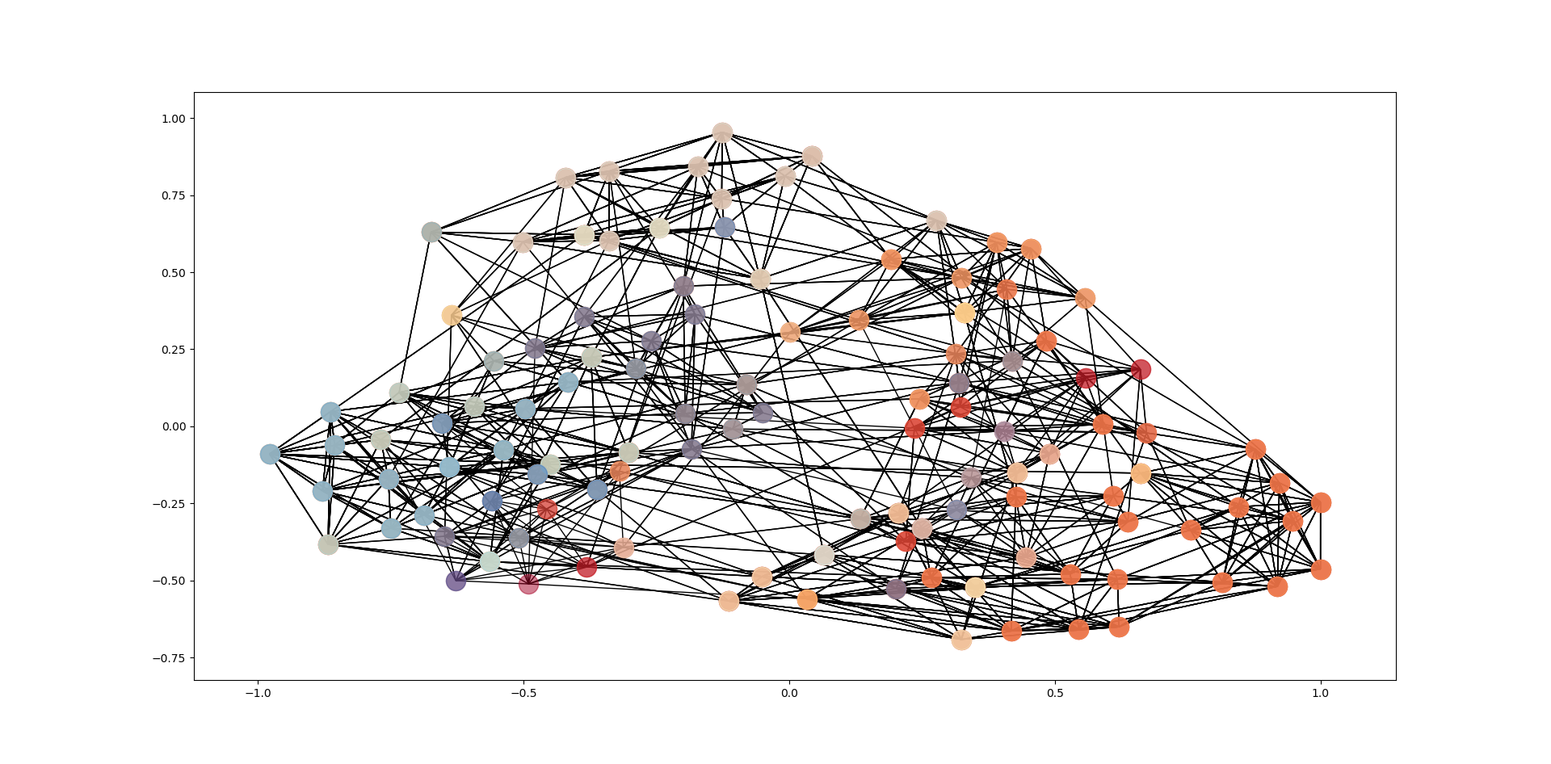
RandomWalk

Slide 11
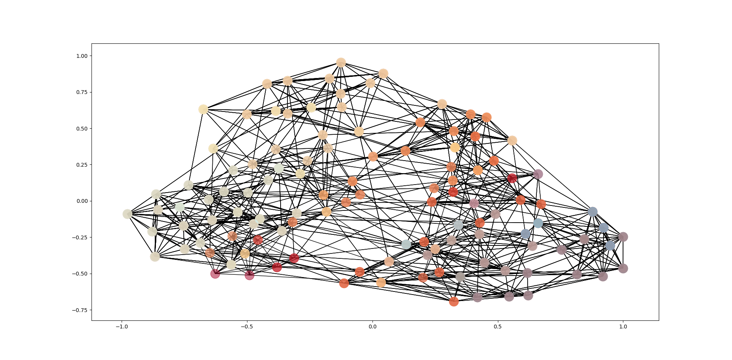
RandomWalk Modified

Slide 12
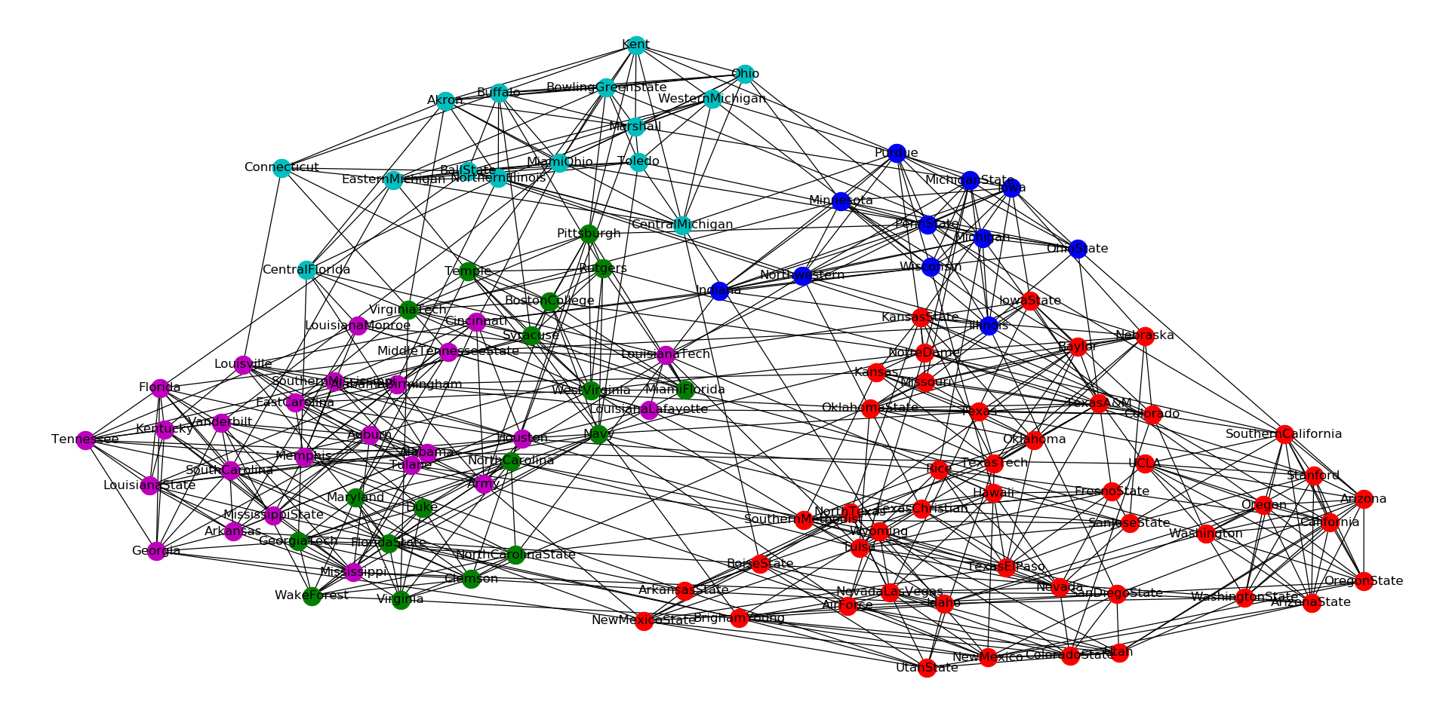
Girvan-Newman
Notes:
3rd level of Girvan-Newman

Slide 13
Clustering Tests
Test2
lambda | 1.2
sim_threshold | 0.01
cluster_merge_threshold | 0.4
NumClusters_PRM | 4
NumClusters_PR | 4
Conductance_PRM | 4.6422
Conductance_Normal | 3.1752
Algortihms were applied on Zachary’s Karate club graph [3].

Slide 14
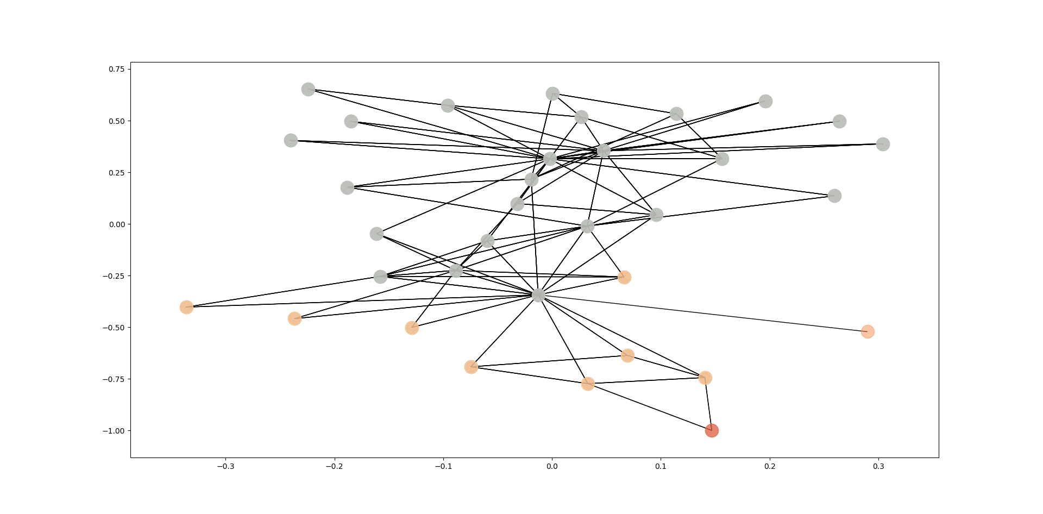
RandomWalk

Slide 15

RandomWalk Modified

Slide 16
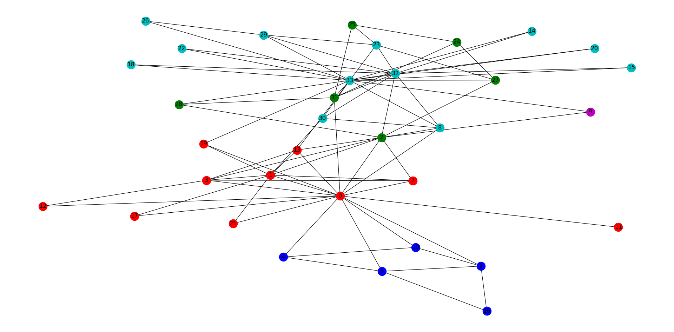
Girvan-Newman

Slide 17
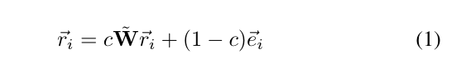
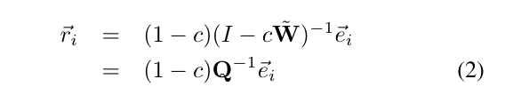
Fast Random Walk with Restart [5]
Two traditional methods of calculating PR:
PreCompute (2)
OnTheFly (1)
Blk []
Notes:
OnTehFly takes time (you compute until (1) converges
Precompute (quadratic space)

Slide 18
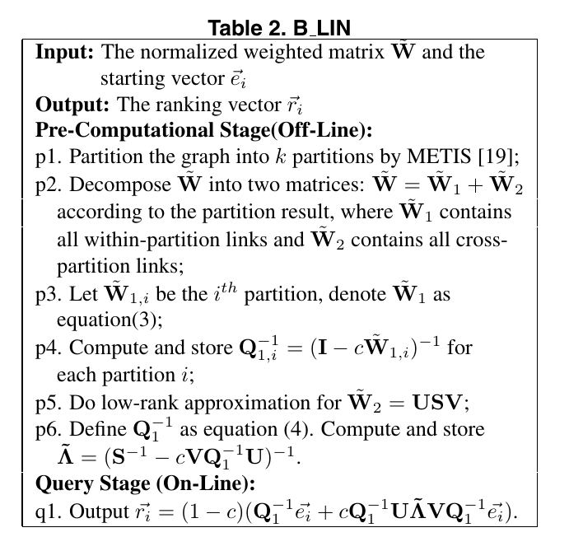



Fast Random Walk with Restart
The Proposed Algorithm:
Me:

Slide 19
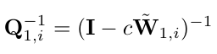
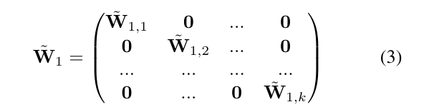
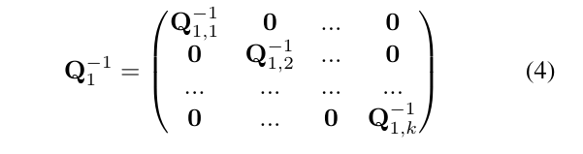
Fast Random Walk with Restart
What I understood:
[This page is intentionally left blank]
Divide the graph into smaller portions
And divide the matrix into two matrices, one containing all links inside the partitions, and one that contains cross sectional links
Compute for each partition
Define W and Q as below equations:

Slide 20

Fast Random Walk with Restart
In the end Fast Random Walk page rank is calculated by this formula:
Benefits: Online computational cost, pre computational cost and storage decreased.

Slide 21
Fast Random Walk with Restart
The reasons we diverged from this paper
Too old (2006)
Complex optimizations
Hard to implement, and improve

Slide 22
Approximate Personalized Page Rank
Also uses the block structure of large networks. Runtime is proportional to the cluster sizes inside network, rather than the whole network size.
Notes:
OnTehFly takes time (you compute until (1) converges
Precompute (quadratic space)

Slide 23
APPR [6]
Algorithm:
Pick a single seed node and run PPR with for that seed node
Sort the seed nodes in decreasing page rang score from step 1
Perform sweeping over the nodes to find clusters

Slide 24
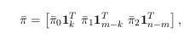

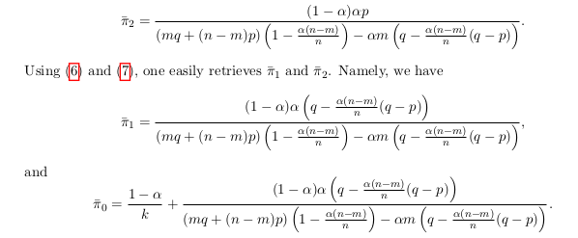
Mean Field Analysis of PPR
There is concentration to the mean field model of PPR when the size of subgraph and number of seeds scale linearly with the graph size [4].

Slide 25
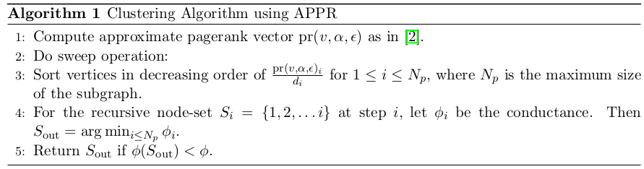
[4]

Slide 26
Conclusion
We have focused on quality and improved it under some conditions. But results depend on the input graph.
We have tried to improve the time of the pagerank but couldn’t improve much. Modified version is faster if added factor causes it to converge faster.

Slide 27
References
[1] M. Girvan and M. E. J. Newman, Community structure in social and biological networks, Proc. Natl. Acad. Sci. USA 99, 7821-7826 (2002).
[2] T.S. Evans, "Clique Graphs and Overlapping Communities", J.Stat.Mech. (2010) P12037 [arXiv:1009.0638]
[3] Zachary, Wayne. (1976). “An Information Flow Model for Conflict and Fission in Small Groups1”. Journal of anthropological research. 33. 10.1086/jar.33.4.3629752.

Slide 28
References
[4] Konstantin Avrachenkov et. al. “Mean Field Analysis of Personalized PageRank with Implications for Local Graph Clustering”. June 20, 2018.
[5] Hanghang Tong et. al. “Fast Random Walk with Restart and Its Applications”. September 2006
[6] R. Andersen, K. Lang and F. Chung, "Local Graph Partitioning using PageRank Vectors," 2006 47th Annual IEEE Symposium on Foundations of Computer Science (FOCS'06)(FOCS), Berkeley, California, 2006, pp. 475-486.

